Slide 1
Sentiment Analysis
Model Performance Report & Insights Document

Slide 2
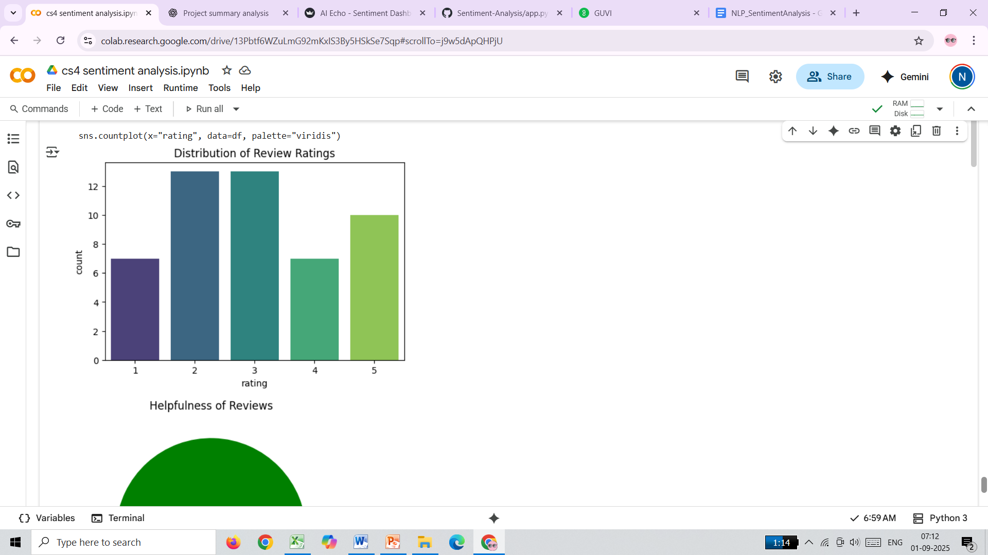
The distribution of review and ratings
INSIGHTS :
“User ratings are spread across all categories, with 2-star and 3-star reviews being the most common. This indicates a mixed sentiment, where many users are neutral or slightly dissatisfied, while positive feedback (4–5 stars) is present but not dominant.”

Slide 3
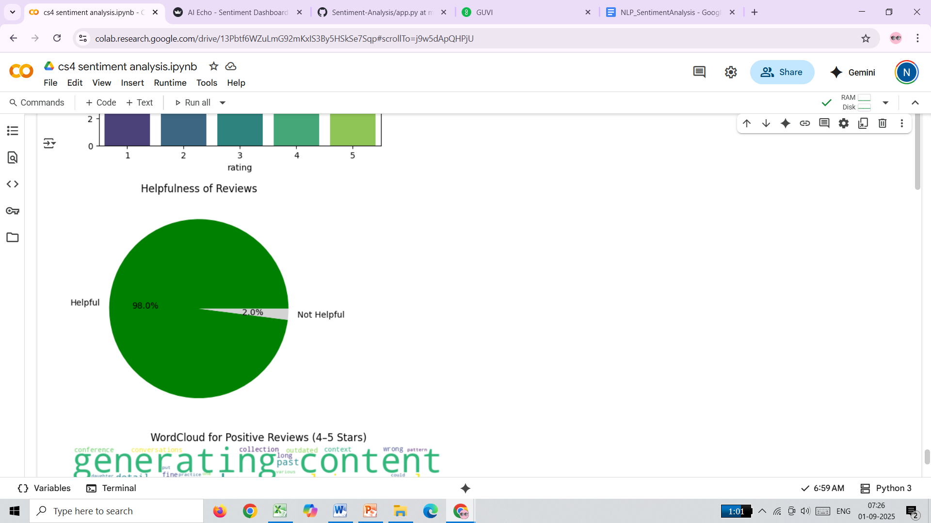
How many reviews were marked as helpful (above a certain threshold
INSIGHTS: “Nearly 98% of reviews are marked as helpful, showing that users value peer feedback and rely on it for decision-making.”

Slide 4
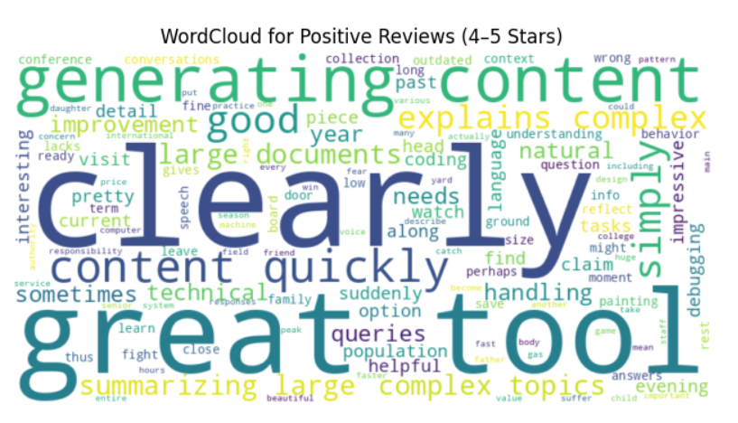
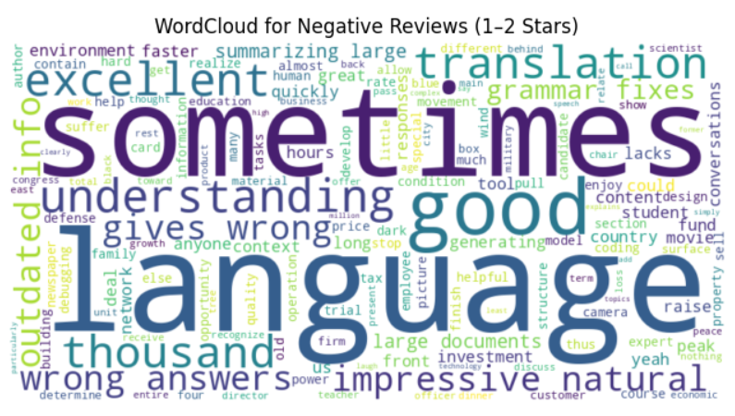
keywords in positive vs. negative reviews
INSIGHTS:
“Positive reviews highlight clarity and usefulness, while negative reviews point to translation errors and inconsistent grammar handling.”

Slide 5
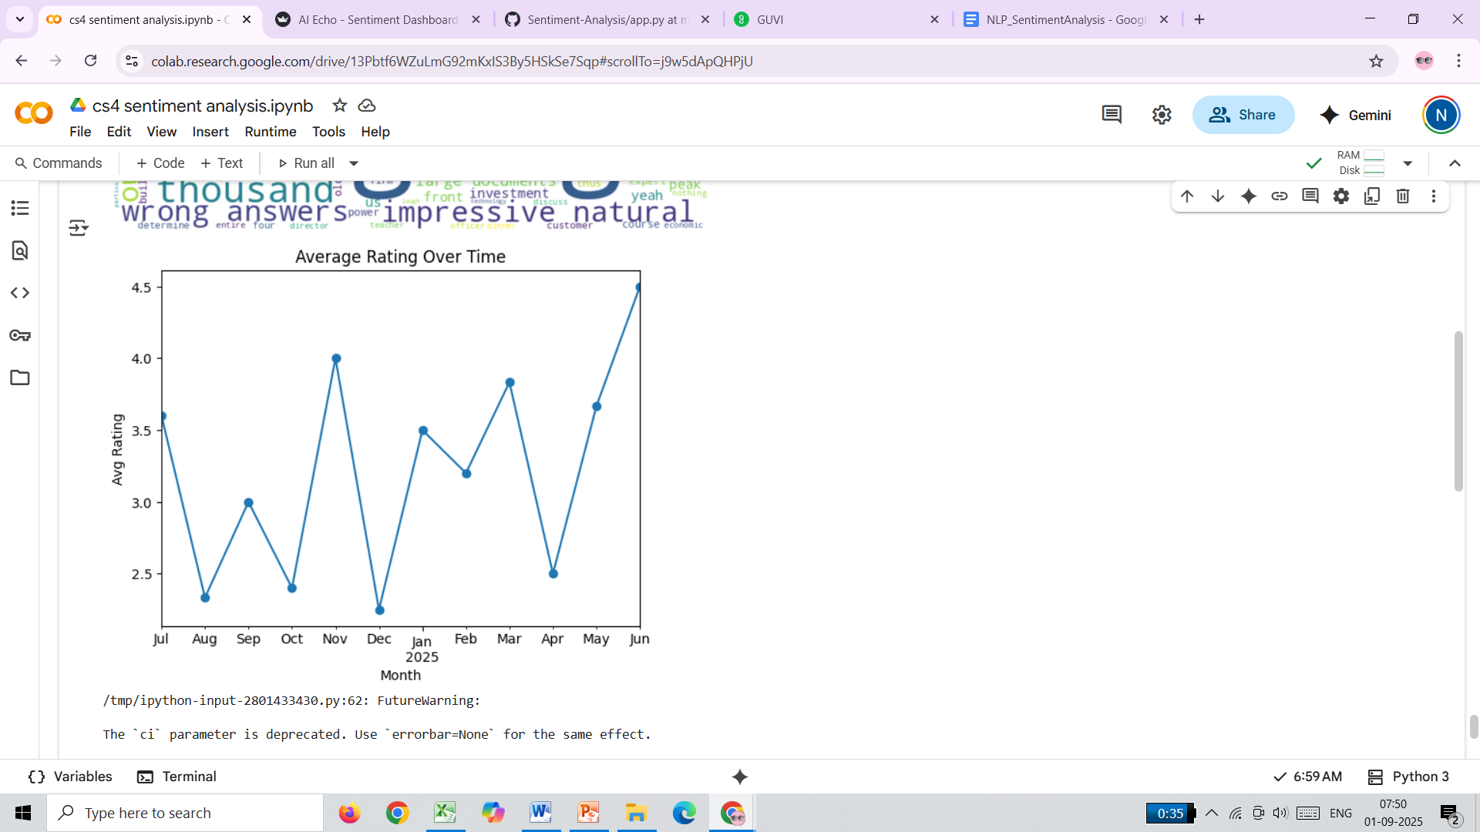
The average rating changed over time
INSIGHTS:
“User satisfaction fluctuated month-to-month, with a major dip in December and a strong recovery by June.”

Slide 6
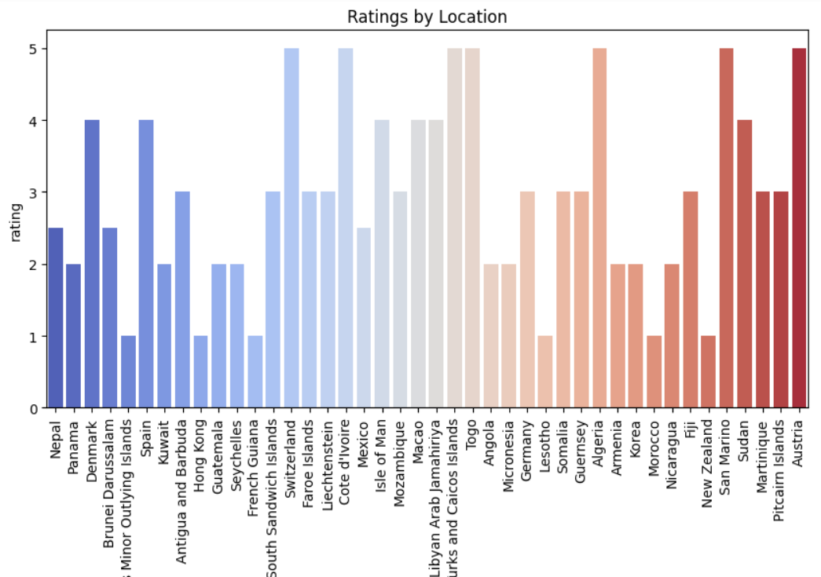
Ratings vary by user location
INSIGHTS:
“User satisfaction varies widely by region — Europe shows higher ratings, while some Asian countries reflect lower experiences.”

Slide 7
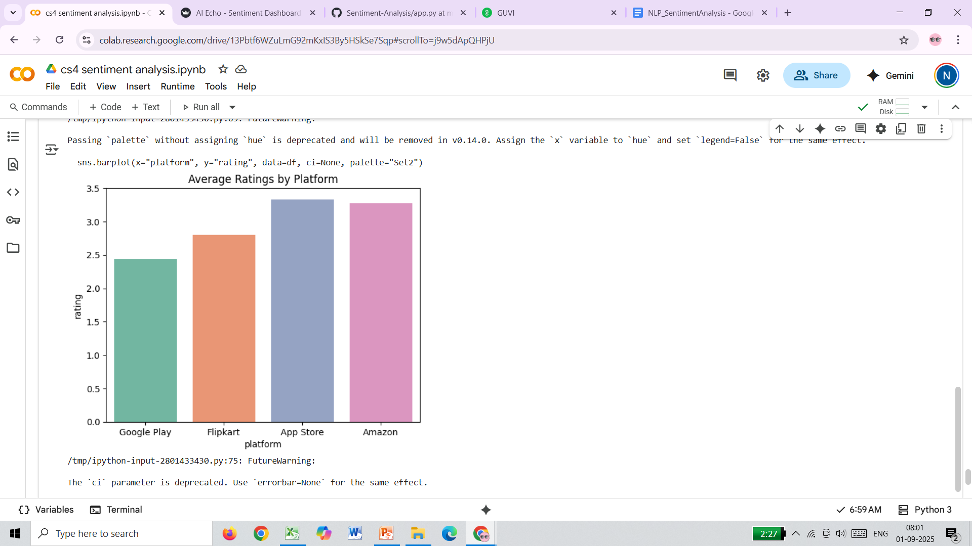
Which platform (Web vs Mobile) gets better reviews
INSIGHTS:
“Users on App Store and Amazon report better experiences, while Google Play users show lower satisfaction — highlighting mobile app issues.”

Slide 8
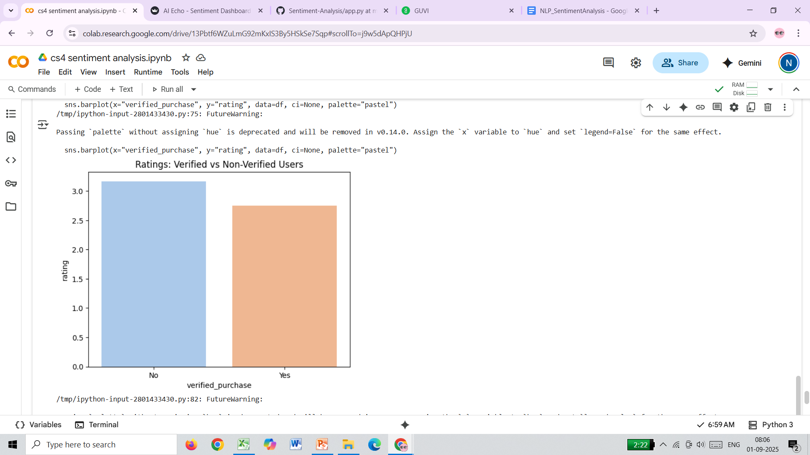
Are verified users more satisfied than non-verified ones
INSIGHTS:
“Verified customers tend to be more critical than non-verified users, highlighting real product improvement areas.”

Slide 9
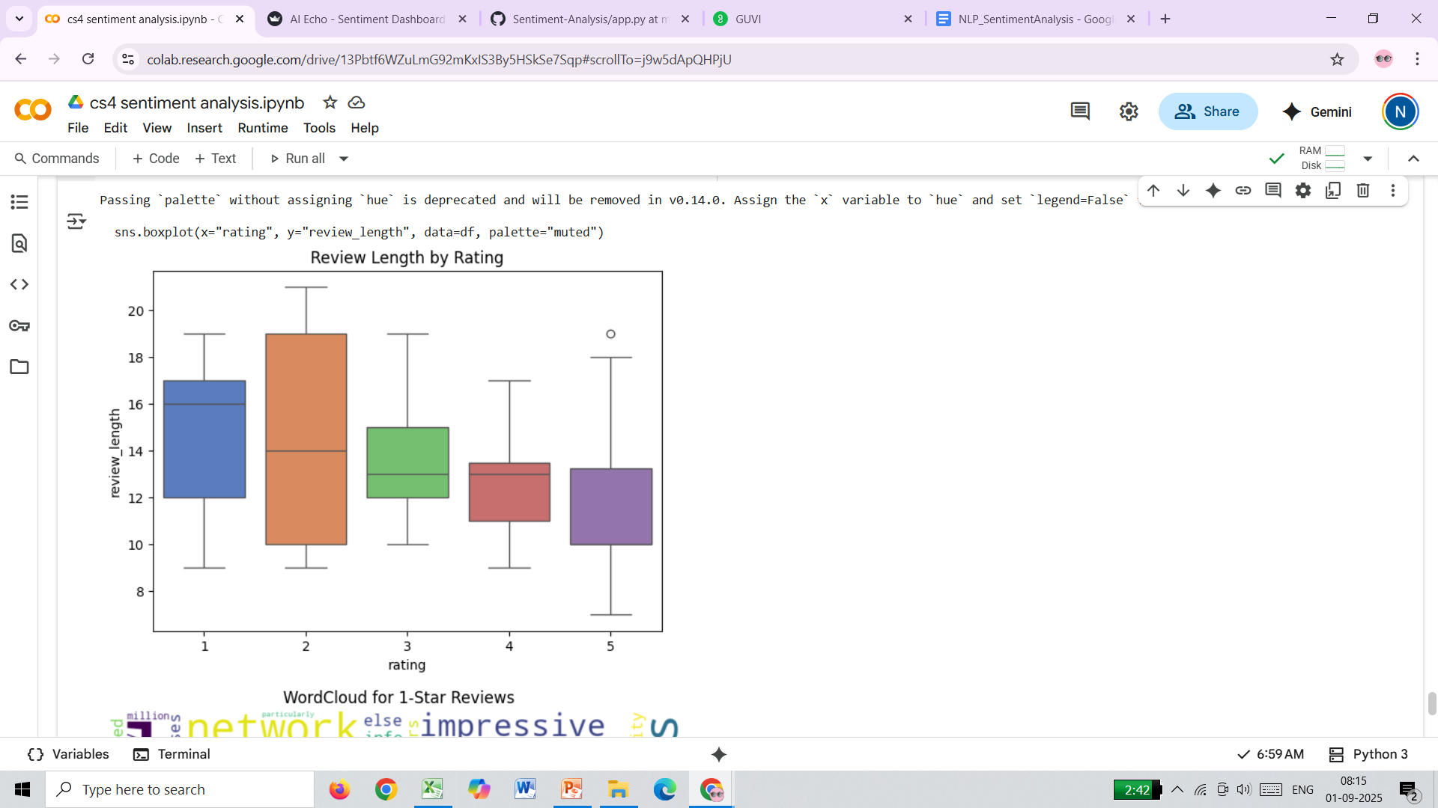
The average length of reviews per rating category
INSIGHTS
“Negative reviews are longer and more descriptive, highlighting detailed issues, while positive reviews are brief and to the point.”

Slide 10
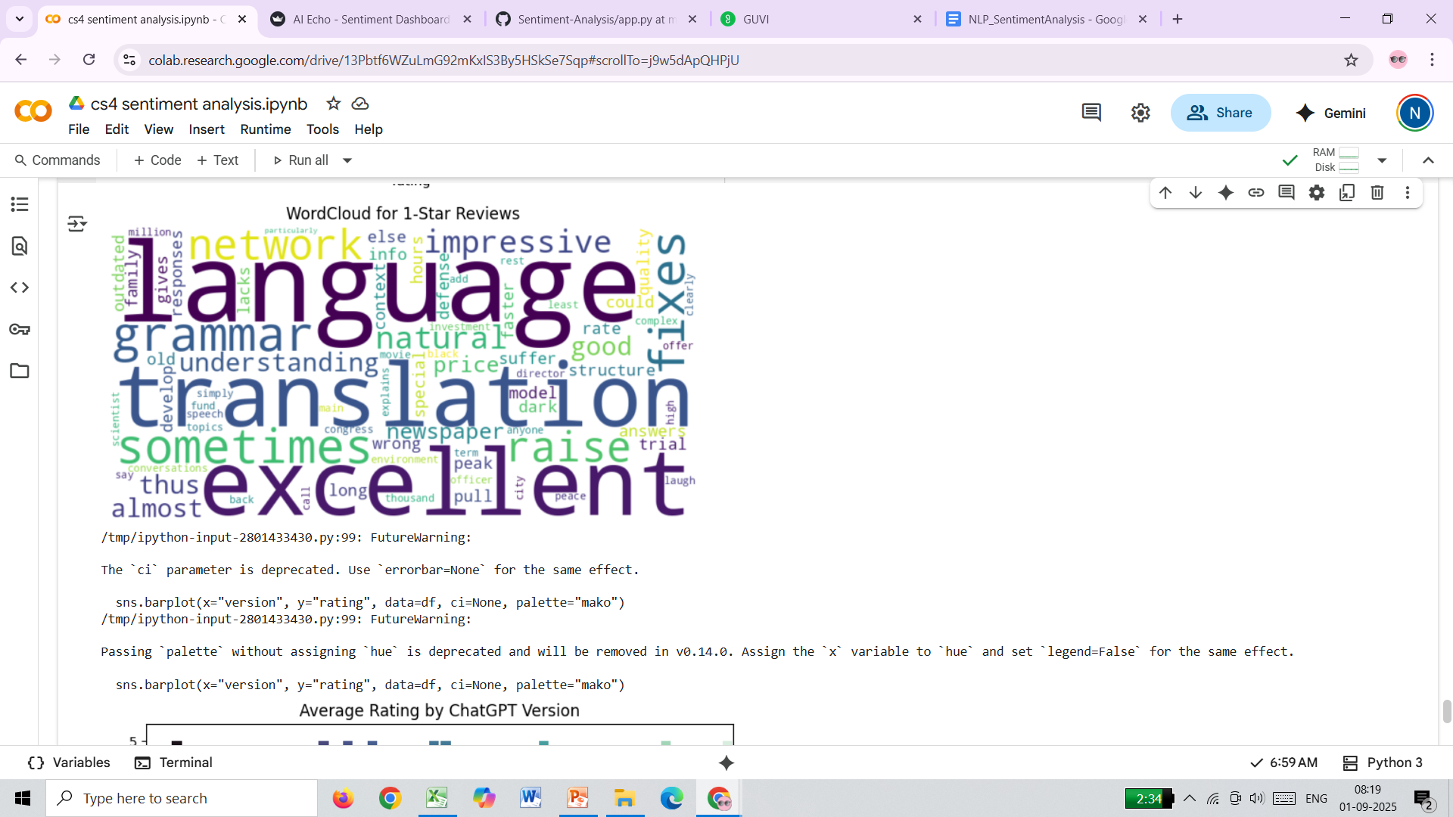
The most mentioned words in 1-star reviews
INSIGHTS
“Low ratings highlight translation and language-related issues, signaling an urgent need for improved grammar, accuracy, and consistency.”

Slide 11
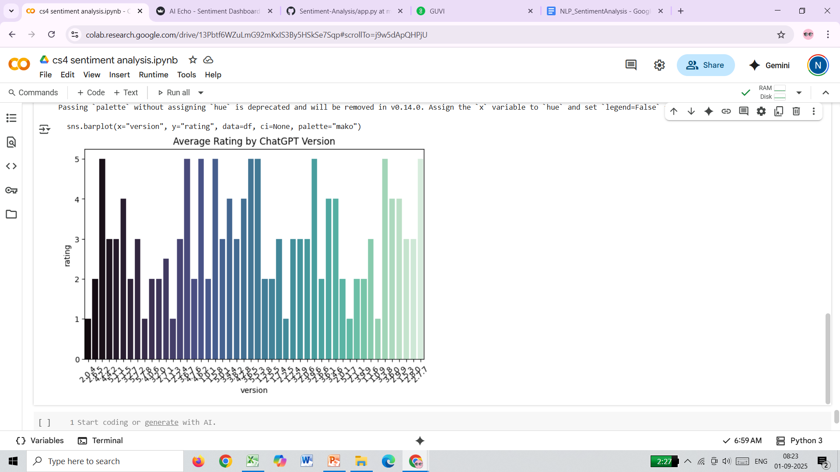
What ChatGPT version received the highest average rating
INSIGHTS:
“Latest ChatGPT version achieved the highest rating, showing significant improvement in quality and user satisfaction over time.”

